Slide 1


© 2012
Notes:
This game plays just like the popular board game, Battleship®.
***How to set up this game template***
1. Come up with 32 review questions and answers.
2. Type the questions into the “Type review question here.” text boxes on slides 3-34. One question per slide.
3. Keep a list of the questions and answers with you, so you know what the answers are (just in case you get caught off-guard).
***How to play Battleship***
1. Divide your class into two even teams. It’s fun to do boys vs. girls if the numbers are roughly equal!
2. Have them sit in a groups (with their teams) and have each team select a captain. The captain is the only person who can pick squares and provide answers. It gets too confusing, otherwise. One team is the Red Team and will try to destroy the three ships hiding beneath the blue squares. The other team is the Blue Team and will try to destroy the three ships hiding beneath the red squares.
3. Choose which team will go first. I like to flip a coin.
4. Have the first team select which square they want to attack. Then, click on their selection in the gray “Questions” box. This will take you to the question that corresponds with that square.
5. Read the group the question. Give them 1 minute to discuss and provide an answer.
6. If the answer they provide is correct, click on the “Return to Board” box. Then, click on the box that they selected. IF there is part of a ship behind that box, you can click on the ship and a bomb will explode on it. After the box has been clicked and the ship has been bombed (if applicable), their turn is over and the other team gets to go.
NOTE: If both parts of a ship have been destroyed, you can reduce the number of ships remaining in the “Ships Remaining” text box.
7. If the answer they provide is incorrect, click on the “Return to Board” box. Their turn is now over and the other team gets to go.
8. The game continues until one team has successfully destroyed all three of their opponents ships.
***Instructions for repeat gameplay***
1. If you intend to use this template multiple times with the same class, it’s easy for them to remember where the ships (and bombs) are so, you’ll need to move them around.
2. To move the ships, you’ll need to move the red and blue boxes first. The ships (and bombs) are underneath the red and blue boxes.
3. I suggest that you select all of the red and blue boxes (at the same time) and use the “cut” and “paste” function to move them to another slide. This will allow you to keep them all together. You can create an entirely new slide at the end of the PowerPoint and then delete if when you’re done making changes.
4. After you’ve moved the red and blue boxes, you can move the ships (and bombs) where you want them on the game board. Each half of the board should have three ships. Make sure you keep the ships and bombs that are stacked on top of each other together.
NOTE: Each of the ships are separated into two halves so that when you click on them during gameplay, both of the bombs do not go off. Each half of the ship is a button, essentially.
5. After you’ve moved the ships (and bombs) to where you want them to be, “cut” and “paste” the red and blue squares back on top of the board.
6. When you’ve made these changes, try playing the game to make sure they work correctly. Don’t forget to delete the extra slide at the end of the presentation (if you made one).
© 2012
Any redistribution or reproduction of part or all of the contents in any form is prohibited. You may not distribute or commercially exploit the content. Nor may you transmit it or store it in any other website or other form of electronic retrieval system.

Slide 2

Rules
  No calculators, books, or phones.
  Teams alternate choosing targets. Every person takes a turn and can consult team members before answering the question. If correct, the target is revealed. The first team to uncover all 3 battleships wins.
  Every person should work every problem even if it’s not their team’s problem.
  If a person is not participating or has a phone out, the team loses a turn, and that person receives a big fat zero for a daily grade.

Slide 3




1
2
3
4
5
6
7
8
A
B
C
D
Ships Remaining:
Ships Remaining:
Questions:
A1
A2
A3
A4
A5
A6
A7
A8
B1
B2
B3
B4
B5
B6
B7
B8
C1
C2
C3
C4
C5
C6
C7
C8
D1
D2
D3
D4
D5
D6
D7
D8
© 2012
Notes:
Notes:
You do not need to edit this slide in order to play the game.
© 2012
Any redistribution or reproduction of part or all of the contents in any form is prohibited. You may not distribute or commercially exploit the content. Nor may you transmit it or store it in any other website or other form of electronic retrieval system.

Slide 4
TARGET: A1
What are the first 3 terms of the Maclaurin series for sinx?
Return to Board
© 2012
Notes:
Setup Notes:
Enter your question into the “Type review question here.” text box.
© 2012
Any redistribution or reproduction of part or all of the contents in any form is prohibited. You may not distribute or commercially exploit the content. Nor may you transmit it or store it in any other website or other form of electronic retrieval system.

Slide 5

TARGET: A2
$xy=x^{2}+2y$ Find $\frac{dy}{dx}.$
Return to Board
© 2012
Notes:
Setup Notes:
Enter your question into the “Type review question here.” text box.
© 2012
Any redistribution or reproduction of part or all of the contents in any form is prohibited. You may not distribute or commercially exploit the content. Nor may you transmit it or store it in any other website or other form of electronic retrieval system.

Slide 6

TARGET: A3
What is the average value of $f\left(x\right)=x^{2}$ on [0,3]?
Return to Board
© 2012
Notes:
Setup Notes:
Enter your question into the “Type review question here.” text box.
© 2012
Any redistribution or reproduction of part or all of the contents in any form is prohibited. You may not distribute or commercially exploit the content. Nor may you transmit it or store it in any other website or other form of electronic retrieval system.

Slide 7
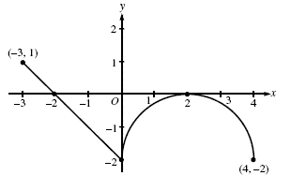
TARGET: A4
This is a graph of f’(x). Where is f(x) decreasing?
Return to Board
© 2012
Notes:
Setup Notes:
Enter your question into the “Type review question here.” text box.
© 2012
Any redistribution or reproduction of part or all of the contents in any form is prohibited. You may not distribute or commercially exploit the content. Nor may you transmit it or store it in any other website or other form of electronic retrieval system.

Slide 8
TARGET: A5
Find the speed at t=2.
Return to Board
© 2012
Notes:
Setup Notes:
Enter your question into the “Type review question here.” text box.
© 2012
Any redistribution or reproduction of part or all of the contents in any form is prohibited. You may not distribute or commercially exploit the content. Nor may you transmit it or store it in any other website or other form of electronic retrieval system.

Slide 9

TARGET: A6
This is the graph of f(x). Find $\int_{−3}^{4}{f\left(x\right).}$
Return to Board
© 2012
Notes:
Setup Notes:
Enter your question into the “Type review question here.” text box.
© 2012
Any redistribution or reproduction of part or all of the contents in any form is prohibited. You may not distribute or commercially exploit the content. Nor may you transmit it or store it in any other website or other form of electronic retrieval system.

Slide 10
TARGET: A7
Find
Return to Board
© 2012
Notes:
Setup Notes:
Enter your question into the “Type review question here.” text box.
© 2012
Any redistribution or reproduction of part or all of the contents in any form is prohibited. You may not distribute or commercially exploit the content. Nor may you transmit it or store it in any other website or other form of electronic retrieval system.

Slide 11
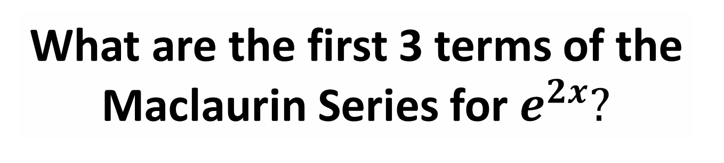
TARGET: A8
What are the first 3 terms of the Maclaurin Series for $e^{2x}?$
Return to Board
© 2012
Notes:
Setup Notes:
Enter your question into the “Type review question here.” text box.
© 2012
Any redistribution or reproduction of part or all of the contents in any form is prohibited. You may not distribute or commercially exploit the content. Nor may you transmit it or store it in any other website or other form of electronic retrieval system.

Slide 12
TARGET: B1
What are the 3 conditions of Rolle’s Theorem?
Return to Board
© 2012
Notes:
Setup Notes:
Enter your question into the “Type review question here.” text box.
© 2012
Any redistribution or reproduction of part or all of the contents in any form is prohibited. You may not distribute or commercially exploit the content. Nor may you transmit it or store it in any other website or other form of electronic retrieval system.

Slide 13
TARGET: B2
What is the formula for finding polar area?
Return to Board
© 2012
Notes:
Setup Notes:
Enter your question into the “Type review question here.” text box.
© 2012
Any redistribution or reproduction of part or all of the contents in any form is prohibited. You may not distribute or commercially exploit the content. Nor may you transmit it or store it in any other website or other form of electronic retrieval system.

Slide 14
TARGET: B3
What is the Mean Value Theorem? Don’t forget to include the conditions.
Return to Board
© 2012
Notes:
Setup Notes:
Enter your question into the “Type review question here.” text box.
© 2012
Any redistribution or reproduction of part or all of the contents in any form is prohibited. You may not distribute or commercially exploit the content. Nor may you transmit it or store it in any other website or other form of electronic retrieval system.

Slide 15
TARGET: B4
x | 1 | 3 | 6
f(x) | 10 | 20 | 40
Estimate f’(2).
Return to Board
© 2012
Notes:
Setup Notes:
Enter your question into the “Type review question here.” text box.
© 2012
Any redistribution or reproduction of part or all of the contents in any form is prohibited. You may not distribute or commercially exploit the content. Nor may you transmit it or store it in any other website or other form of electronic retrieval system.

Slide 16
TARGET: B5
x | 1 | 3 | 6
f(x) | 10 | 20 | 40
Estimate
using a trapezoidal approximation with 2 subintervals.
Return to Board
© 2012
Notes:
Setup Notes:
Enter your question into the “Type review question here.” text box.
© 2012
Any redistribution or reproduction of part or all of the contents in any form is prohibited. You may not distribute or commercially exploit the content. Nor may you transmit it or store it in any other website or other form of electronic retrieval system.

Slide 17
TARGET: B6
f(x) is a continuous, increasing function. Is a left Riemann sum an over or under approximation?
Return to Board
© 2012
Notes:
Setup Notes:
Enter your question into the “Type review question here.” text box.
© 2012
Any redistribution or reproduction of part or all of the contents in any form is prohibited. You may not distribute or commercially exploit the content. Nor may you transmit it or store it in any other website or other form of electronic retrieval system.

Slide 18
TARGET: B7
f’’(x) < 0. Will a tangent line approximation for f(x) be an under or over approximation?
Return to Board
© 2012
Notes:
Setup Notes:
Enter your question into the “Type review question here.” text box.
© 2012
Any redistribution or reproduction of part or all of the contents in any form is prohibited. You may not distribute or commercially exploit the content. Nor may you transmit it or store it in any other website or other form of electronic retrieval system.

Slide 19
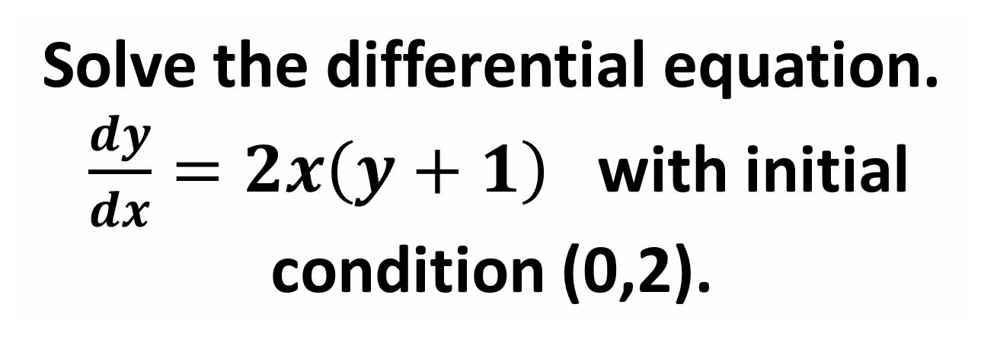
TARGET: B8
Solve the differential equation. $\frac{dy}{dx}=2x\left(y+1\right)$ with initial condition (0,2).
Return to Board
© 2012
Notes:
Setup Notes:
Enter your question into the “Type review question here.” text box.
© 2012
Any redistribution or reproduction of part or all of the contents in any form is prohibited. You may not distribute or commercially exploit the content. Nor may you transmit it or store it in any other website or other form of electronic retrieval system.

Slide 20
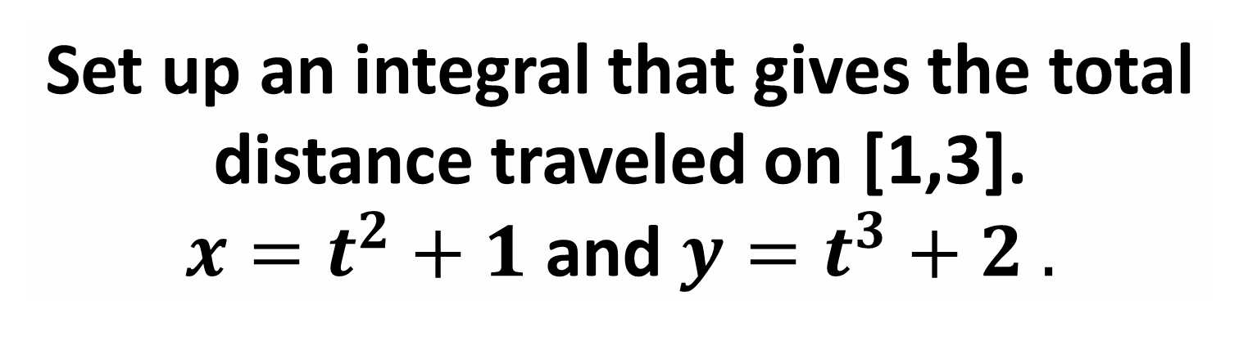
TARGET: C1
Set up an integral that gives the total distance traveled on [1,3].
$x=t^{2}+1$ and $y=t^{3}+2 .$
Return to Board
© 2012
Notes:
Setup Notes:
Enter your question into the “Type review question here.” text box.
© 2012
Any redistribution or reproduction of part or all of the contents in any form is prohibited. You may not distribute or commercially exploit the content. Nor may you transmit it or store it in any other website or other form of electronic retrieval system.

Slide 21

TARGET: C2
$r=2sinϴ$
Write an expression for x.
Return to Board
© 2012
Notes:
Setup Notes:
Enter your question into the “Type review question here.” text box.
© 2012
Any redistribution or reproduction of part or all of the contents in any form is prohibited. You may not distribute or commercially exploit the content. Nor may you transmit it or store it in any other website or other form of electronic retrieval system.

Slide 22
TARGET: C3
When is a particle is speeding up?
Return to Board
© 2012
Notes:
Setup Notes:
Enter your question into the “Type review question here.” text box.
© 2012
Any redistribution or reproduction of part or all of the contents in any form is prohibited. You may not distribute or commercially exploit the content. Nor may you transmit it or store it in any other website or other form of electronic retrieval system.

Slide 23

TARGET: C4
Find the antiderivative of $∫3^{x}dx$
Return to Board
© 2012
Notes:
Setup Notes:
Enter your question into the “Type review question here.” text box.
© 2012
Any redistribution or reproduction of part or all of the contents in any form is prohibited. You may not distribute or commercially exploit the content. Nor may you transmit it or store it in any other website or other form of electronic retrieval system.

Slide 24

TARGET: C5
Find the antiderivative of $\int{\frac{1}{x^{2}+1}}dx$
Return to Board
© 2012
Notes:
Setup Notes:
Enter your question into the “Type review question here.” text box.
© 2012
Any redistribution or reproduction of part or all of the contents in any form is prohibited. You may not distribute or commercially exploit the content. Nor may you transmit it or store it in any other website or other form of electronic retrieval system.

Slide 25
TARGET: C6
This is a graph of f’(x). Where is f(x) concave down?
Return to Board
© 2012
Notes:
Setup Notes:
Enter your question into the “Type review question here.” text box.
© 2012
Any redistribution or reproduction of part or all of the contents in any form is prohibited. You may not distribute or commercially exploit the content. Nor may you transmit it or store it in any other website or other form of electronic retrieval system.

Slide 26
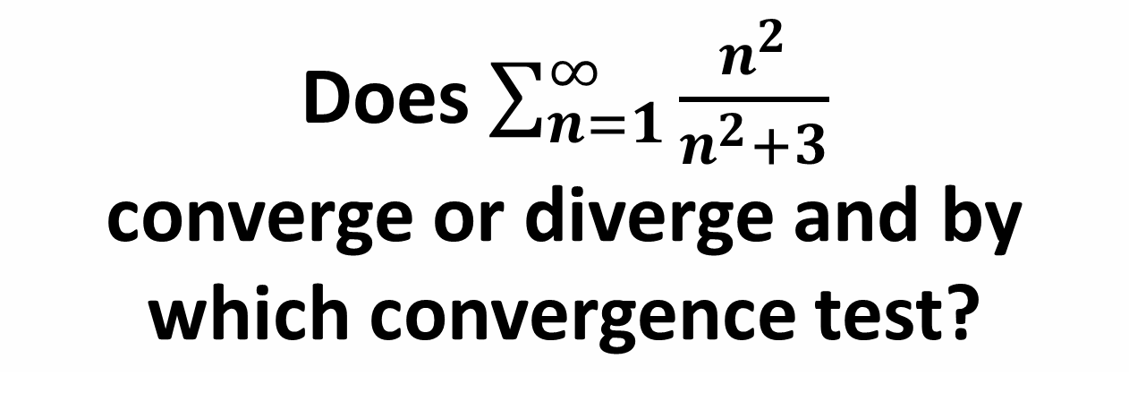
TARGET: C7
Does $\sum_{n=1}^{∞}{\frac{n^{2}}{n^{2}+3}}$
converge or diverge and by which convergence test?
Return to Board
© 2012
Notes:
Setup Notes:
Enter your question into the “Type review question here.” text box.
© 2012
Any redistribution or reproduction of part or all of the contents in any form is prohibited. You may not distribute or commercially exploit the content. Nor may you transmit it or store it in any other website or other form of electronic retrieval system.

Slide 27

TARGET: C8
$$\frac{d}{dx}\int_{3}^{x^{2}}{sin(t)dt }$$
Return to Board
© 2012
Notes:
Setup Notes:
Enter your question into the “Type review question here.” text box.
© 2012
Any redistribution or reproduction of part or all of the contents in any form is prohibited. You may not distribute or commercially exploit the content. Nor may you transmit it or store it in any other website or other form of electronic retrieval system.

Slide 28
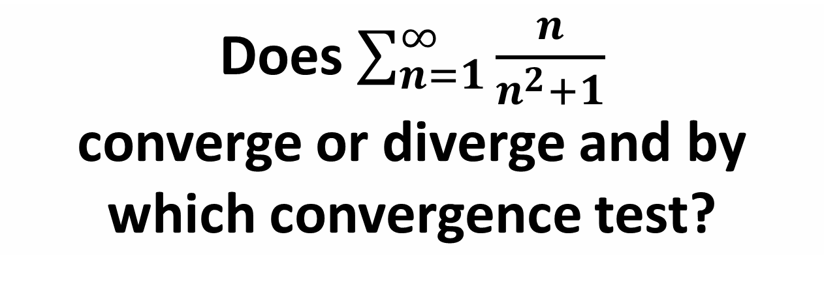
TARGET: D1
Does $\sum_{n=1}^{∞}{\frac{n}{n^{2}+1}}$
converge or diverge and by which convergence test?
Return to Board
© 2012
Notes:
Setup Notes:
Enter your question into the “Type review question here.” text box.
© 2012
Any redistribution or reproduction of part or all of the contents in any form is prohibited. You may not distribute or commercially exploit the content. Nor may you transmit it or store it in any other website or other form of electronic retrieval system.

Slide 29

TARGET: D2
Does $\sum_{0}^{∞}{\frac{2^{n}}{n!}}$
converge or diverge?
Return to Board
© 2012
Notes:
Setup Notes:
Enter your question into the “Type review question here.” text box.
© 2012
Any redistribution or reproduction of part or all of the contents in any form is prohibited. You may not distribute or commercially exploit the content. Nor may you transmit it or store it in any other website or other form of electronic retrieval system.

Slide 30

TARGET: D3
Does$\sum_{1}^{∞}{1/n^{3}}$
converge or diverge?
Return to Board
© 2012
Notes:
Setup Notes:
Enter your question into the “Type review question here.” text box.
© 2012
Any redistribution or reproduction of part or all of the contents in any form is prohibited. You may not distribute or commercially exploit the content. Nor may you transmit it or store it in any other website or other form of electronic retrieval system.

Slide 31
TARGET: D4
What is the general formula for a Taylor series centered at x=a?
Return to Board
© 2012
Notes:
Setup Notes:
Enter your question into the “Type review question here.” text box.
© 2012
Any redistribution or reproduction of part or all of the contents in any form is prohibited. You may not distribute or commercially exploit the content. Nor may you transmit it or store it in any other website or other form of electronic retrieval system.

Slide 32
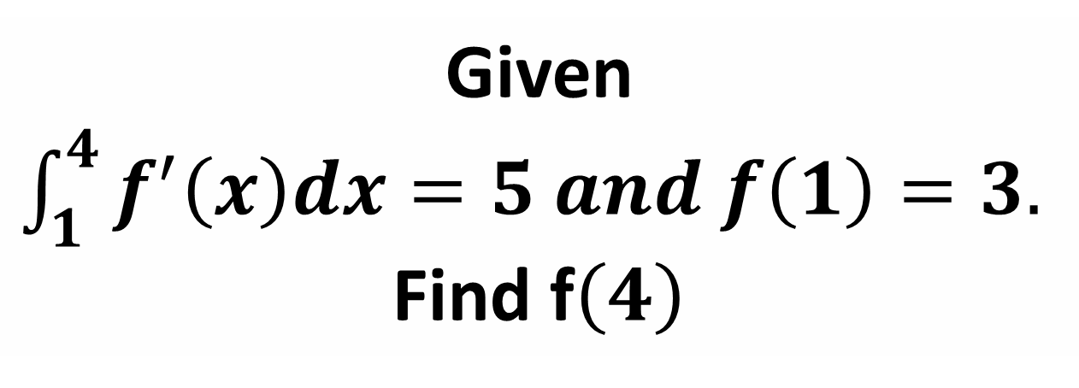
TARGET: D5
Given $\int_{1}^{4}{f^{′}\left(x\right)dx=5 and f\left(1\right)=3. }$ Find f$\left(4\right)$
Return to Board
© 2012
Notes:
Setup Notes:
Enter your question into the “Type review question here.” text box.
© 2012
Any redistribution or reproduction of part or all of the contents in any form is prohibited. You may not distribute or commercially exploit the content. Nor may you transmit it or store it in any other website or other form of electronic retrieval system.

Slide 33
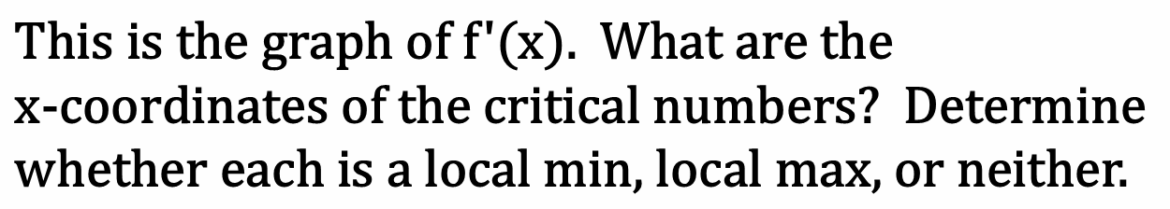
TARGET: D6
$$\text{T}\text{his} \text{is} \text{the} \text{graph} \text{of} \text{f}\text{′(}\text{x}\text{). }\text{What} \text{are} \text{the} \text{x}\text{−}\text{coordinates} \text{of} \text{the} \text{critical} \text{numbers}\text{? }\text{Determine} \text{whether} \text{each} \text{is} \text{a} \text{local} \text{min}\text{, }\text{local} \text{max}\text{, }\text{or} \text{neither}\text{.}$$
Return to Board
© 2012
Notes:
Setup Notes:
Enter your question into the “Type review question here.” text box.
© 2012
Any redistribution or reproduction of part or all of the contents in any form is prohibited. You may not distribute or commercially exploit the content. Nor may you transmit it or store it in any other website or other form of electronic retrieval system.

Slide 34
TARGET: D7
What’s the general term for the Maclaurin series for cosx?
Return to Board
© 2012
Notes:
Setup Notes:
Enter your question into the “Type review question here.” text box.
© 2012
Any redistribution or reproduction of part or all of the contents in any form is prohibited. You may not distribute or commercially exploit the content. Nor may you transmit it or store it in any other website or other form of electronic retrieval system.

Slide 35

TARGET: D8
$$\int{xcosxdx}$$
Return to Board
© 2012
Notes:
Setup Notes:
Enter your question into the “Type review question here.” text box.
© 2012
Any redistribution or reproduction of part or all of the contents in any form is prohibited. You may not distribute or commercially exploit the content. Nor may you transmit it or store it in any other website or other form of electronic retrieval system.

